Slide 1

String vs StringBuilder
Java provides a mutable class that lets us change its text value.
This is the StringBuilder Class.
COMPLETE JAVA MASTERCLASS
The StringBuilder class

Slide 2
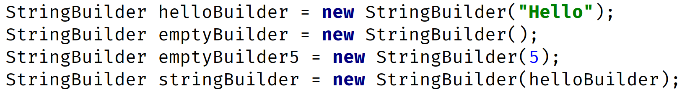
Creating Instances
Instantiating String Objects
Instantiating StringBuilder Objects
There are four ways to create a new StringBuilder object, using the new keyword:
Pass a String.
Pass no arguments at all.
Pass an integer value.
Pass some other type of character sequence (like StringBuilder).
COMPLETE JAVA MASTERCLASS
The StringBuilder class

Slide 3
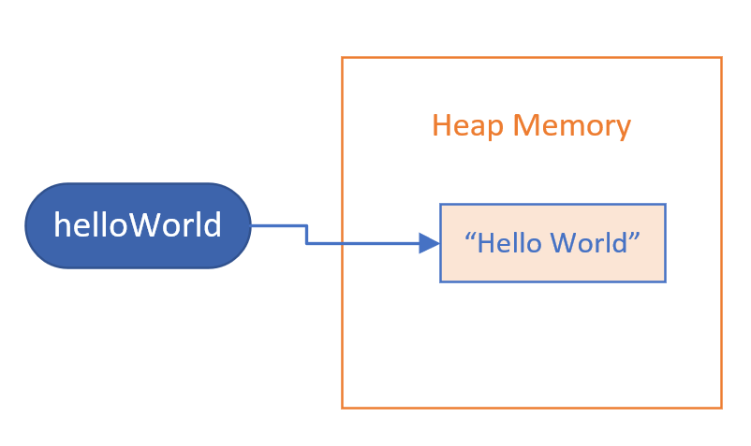
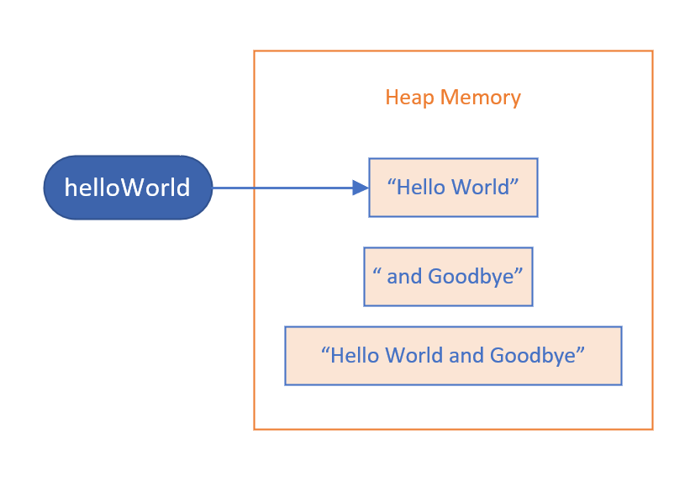
String
Memory before executing helloWorld.concat method
Memory after executing helloWorld.concat method
When we passed the String literal, "and Goodbye", to the concat method, this created an Object in memory for that literal, "and Goodbye".
It also created the result of the concat method, the object, the String, that has the value, "Hello World and Goodbye".
COMPLETE JAVA MASTERCLASS
The StringBuilder class

Slide 4
String
Memory before executing helloWorld.concat method
Memory after executing helloWorld.concat method
These methods don't change the internals of the existing String object.
The String referenced by the helloWorld variable never changed, instead a new String was created by the method call.
COMPLETE JAVA MASTERCLASS
The StringBuilder class

Slide 5
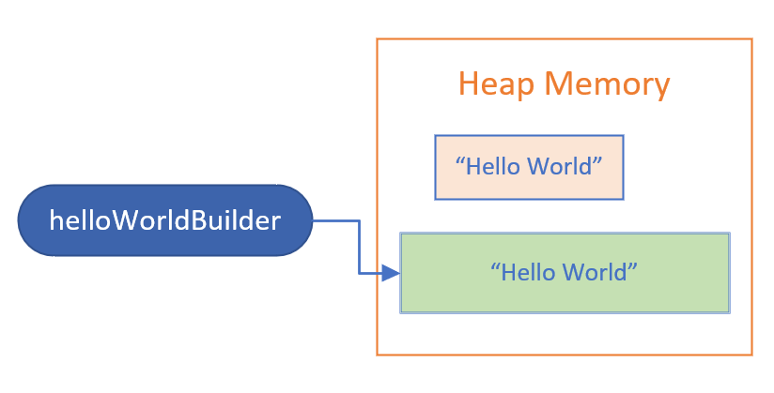
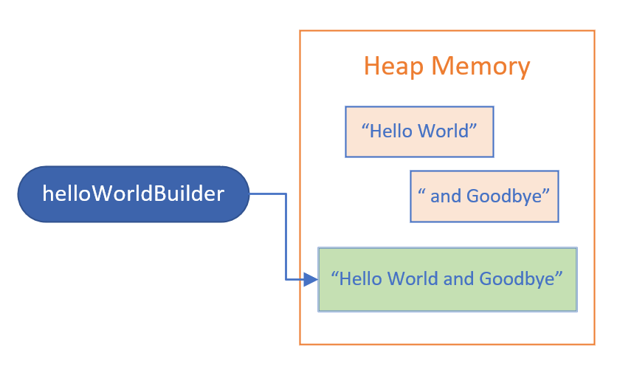
StringBuilder
Memory before executing helloWorldBuilder.append method
Memory after executing helloWorldBuilder.append method
On this slide, Strings and StringBuilders are shown in different colors, with the StringBuilder object in green.
After the call to the append method, we still only have one StringBuilder object.
COMPLETE JAVA MASTERCLASS
The StringBuilder class

Slide 6
StringBuilder
Memory before executing helloWorldBuilder.append method
Memory after executing helloWorldBuilder.append method
The variable helloWorldBuilder, is still referencing the same object, but the value of that object changed.
This is important, because it means the character sequence in the StringBuilder changed.
COMPLETE JAVA MASTERCLASS
The StringBuilder class

Slide 7
String methods vs. StringBuilder methods
String methods create a new object in memory, and return a reference to this new object.
StringBuilder methods return a StringBuilder reference, but it's really a self-reference.
COMPLETE JAVA MASTERCLASS
The StringBuilder class

Slide 8
Some methods unique to the StringBuilder class
A StringBuilder class has many similar methods to Strings.
But it also has methods to remove and insert characters or Strings, and truncate it's size.
But it also has methods to remove and insert characters or Strings, and truncate it's size.
method | description
delete deleteCharAt | You can delete a substring using indices to specify a range, or delete a single character at an index.
insert | You can insert text at a specified position.
reverse | You can reverse the order of the characters in the sequence.
setLength | setLength can be used to truncate the sequence, or include null sequences to 'fill out' the sequence to that length.
COMPLETE JAVA MASTERCLASS
The StringBuilder class

